Slide 1
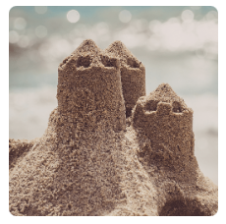
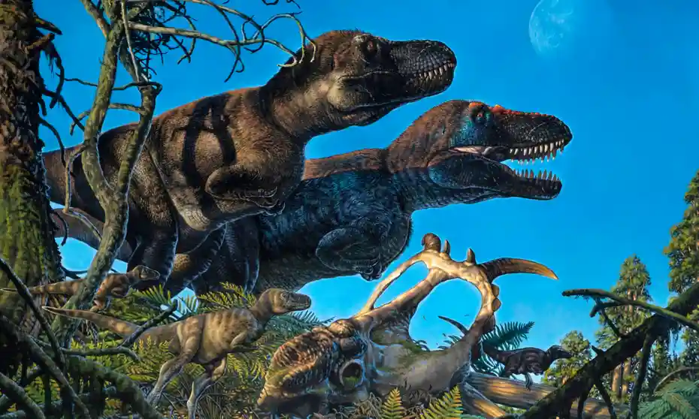
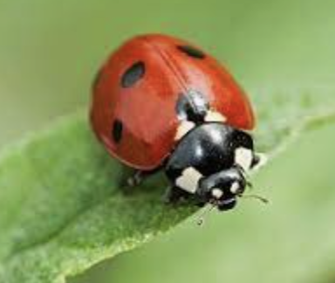
Long term plan 2022/2023
Advent (Term 1)
Lent (Term 2)
Pentecost (Term 3)
Why do ladybirds have spots? (Mini Beasts)
Me and my community
Exploring Autumn
Once Upon a Time
Dinosaurs
On the beach
Children start by focusing on themselves, talking about family which helps them feel comfortable in their first few weeks at school.
Pupils should begin to talk about people in their community, what they do, and roleplay people they can identify such as police officers, firefighter and paramedics/ doctors/. nurses. They should also be able to talk about what they could do to help their community.
The children can also make links between what their parents/ carters do as an occupation and how they help people.
Focus on what experiences of autumn they have already (What is autumn and what might we do in autumn). This includes holidays, games etc.
The children should be introduced to what happens during autumn regarding changes in nature. This includes types of animals, habitats and what they may eat.
The children will be encouraged to explore the outside spaces around school and outside of school. They can go on hunts and share finding with each other and make comparisons to other times of the year.
Focus on what minibeasts they can identify already and what they know about them from experiences.
There should be a focus on firstly identifying a minibeast and their features. Then there should be a look into habitat and how they live. Minibeasts will be in the class in tanks so the children can explore and observe how they live and move.
After this, we will investigate diet and what they might eat and life cycles butterflies.
This project teaches children about the plants and animals that live at the seaside. It also explores holidays in the past and the importance of keeping safe in the Sun.
This topic focuses mainly on UW, EAD, Maths and Literacy. The children should experience what the seaside is like even if they have not been before. They will experience walking in sand and water, building in the sand, playing summer beach games and hunting for animals associated with the beach and summer.
This project supports children to develop a love of stories and reading. It encourages children to learn, retell and act out familiar and traditional tales including Cinderella, Goldilocks, Little Red Riding Hood, The Three Little Pigs and The Three Billy Goats Gruff.
The children will learn that traditional tales have been told to children for hundreds of years and that they are set in the past. They will learn that they usually include animals and some are made up like trolls.
This dinosaur topic has a large focus on the past and understanding the world. The children, like in other topics, will be commenting and showing what they already know about dinosaurs during CP activities in the first week.
The children will then be introduced to specific areas within the dinosaur topic such as ’what are dinosaurs?’ and looking at the natural world and comparing them to animals in present day.
Finally, the children will look at what happened to the dinosaurs and begin to talk about extinction and changes to earth.

